Slide 1
Project Report: Echo Team Presentation
A short presentation showing our work.

Slide 2
Team Information
The Echo team is a team of five from the DATA track. Its members are:
Toyibat Adele
Chidera Jennifer Udoh
Nnenna Edeh
Okorie Ugonma Regina
Osaruonamen Olu-Osawe

Slide 3
Project Information
We were tasked with using a SQLite database to write queries that answer the following:
What is the most popular release type?
For the last three years, what release type has the most torrents?
Who are the top five most common artists?
What is the average number of downloads?

Slide 4
First steps
Each team member was assigned the task of writing a query and a well-detailed report to answer a question.
To accomplish this while maintaining an ease of workflow, we used the following tools:
DB Browser for SQLite, to write and run the queries
Slack, for effective team communication
ClickUp, for easy task management
Google drive, for easy file access and management
Github, for easy file and code access

Slide 5
PROJECT WORKFLOW
Team gets individual tasks assigned
Present project to facilitators and the whole track.
Project start date
02.11.22
06.11.22
08.11.22
10.11.22
11.10.22
Team starts working on the project prerequisites
Team finishes their task and make submission

Slide 6
STEPS TAKEN TO COMPLETE THE PROJECT

Slide 7
Pre-querying
Before starting the task, we did proper research and educated ourselves on the basics of SQL. We also confirmed that our dataset had no missing value and that it had the correct data type. This was to ensure that our answers were accurate and that we didn’t into errors while running our queries.

Slide 8
Task 1 - Okorie Ugonma Regina
“What is the most popular release type?”
Query
SELECT DISTINCT releasetype, COUNT(*)
FROM torrents
GROUP BY releasetype
ORDER BY COUNT(*) DESC;
Result
The most popular release type is ‘album’ with a total count of 35,233.

Slide 9
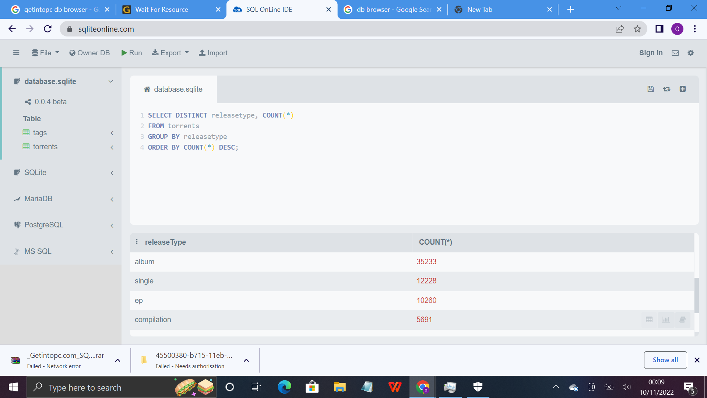
A picture of the query and the result gotten

Slide 10
Task 2 - Osaruonamen Olu-Osawe
“For the last three years, what release type has the most torrents?”
Query
SELECT releaseType, SUM(totalSnatched) AS ‘totalDownloads’
FROM torrents
WHERE groupyear >= 2014
GROUPBY releaseType
ORDER BY totalDownloads DESC
LIMIT 1;
Result
The release type with the most torrents from the last three years, was Album with a total download of 1,387,307.

Slide 11
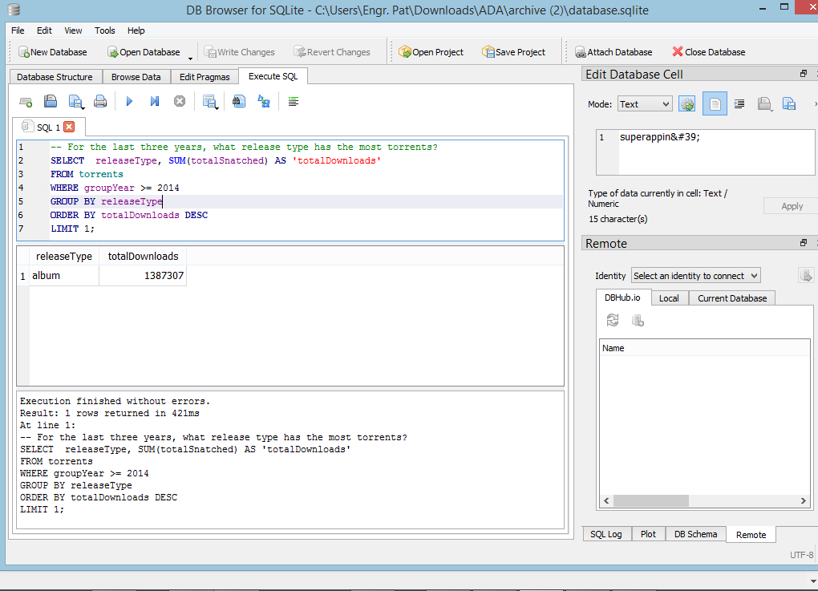
A picture of the query and the result gotten

Slide 12
Task 3 - Chidera Jennifer Udoh
“Who are the top five most common artists?”
Query
SELECT artist, COUNT(artist)
FROM torrents
GROUP BY artist
ORDER BY COUNT(artist) DESC
LIMIT 6;
Result
DJ screw
Eminem
2pac
Lil Wayne
Kanye west

Slide 13
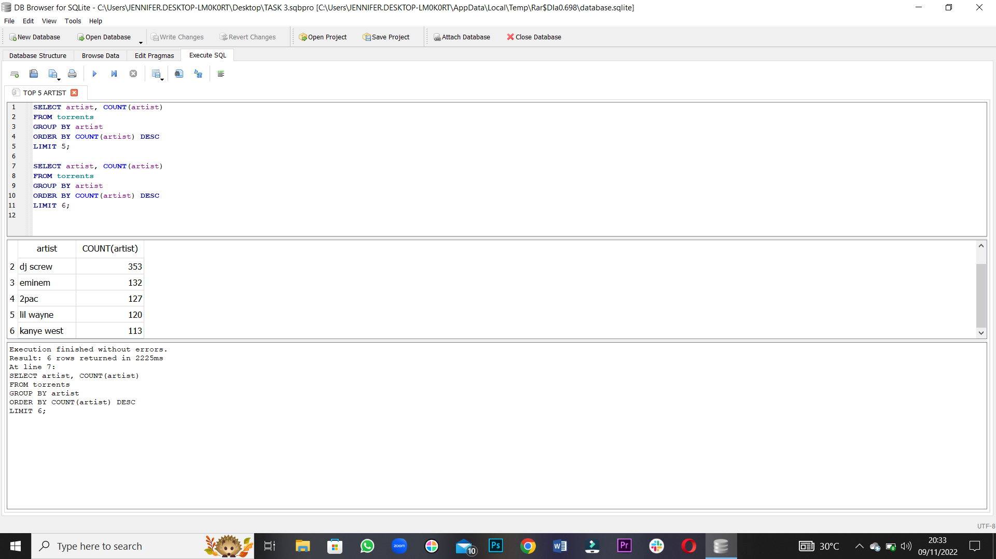
A picture of the query and the result gotten

Slide 14
Task 4 - Nnenna Edeh
“What is the average number of downloads?”
Query
SELECT avg(totalSnatched)
FROM torrents;
SELECT ROUND(207.057792628006,2)
Result
207.06 average downloads were made, from the torrents table.

Slide 15
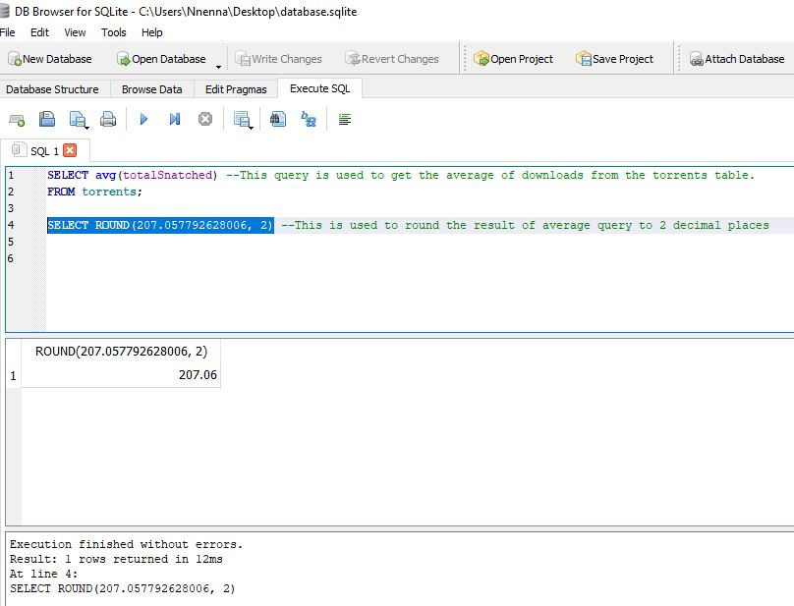
A picture of the query and the result gotten

Slide 16
CONCLUSIONS
After writing and running the queries, these are the answers to the questions:
What is the most popular release type? -> The most popular release type is ‘Album’ and it has a total count of 35,233.
For the last three years, what release type has the most torrents? -> The release type with the most torrent from the last three years was Album, with a total download of 1,387,307.
Who are the top five most common artists? -> Top 5 most common artists are DJ screw, Eminem, 2pac, Lil Wayne, and Kanye west.
What is the average number of downloads? -> The average number of downloads is 207.06.

